Slide 1

INTRODUCING
KMC School
Management System
A web-based portal for students, teachers & parents
with AI-powered Chats
🚀 KMC SMP v1.0 • Firebase • AI

Slide 2
Project Overview
🏫
👥
⚙️
☁️
🤖
User Friendly
2
20+
100%
AI
User
Roles
Features
Cloud
Based
Powered
KMC School Management System (KMC SMP) is a web-based platform that streamlines academic processes, enhances communication between students, teachers, and parents. Features include real-time attendance tracking with charts, homework management, notices, parent feedback system with reply tracking, class chat with AI bot integration. Built on Firebase cloud infrastructure with Python automation and Gemini AI integration.

Slide 3
Student Portal Features
01
02
03
📊 Dashboard
📅 Timetable
📚 Homework
Personal welcome message, today's schedule, exam countdown timer, Nepal time integration.
Interactive weekly schedule showing 8 periods daily (9:30 AM – 4:15 PM), live period highlighting.
View all assignments with title, description, due dates, and images. Real-time Firebase sync.
04
06
07
📢 Notices
💬 Class Chat
📆Calendar
School announcements, exam routines with Nepali dates, competition notices like KMC Hackathon 2026.
Real-time messaging. Students can do @bot Question the AI bot to get instant answers to questions.
A calendar page is to view school events and holydays.
08
09
🆔Digital ID Card
🔐Secure System
It has password based accounts.
Digital ID card can be used if physical ID card is lost.

Slide 4
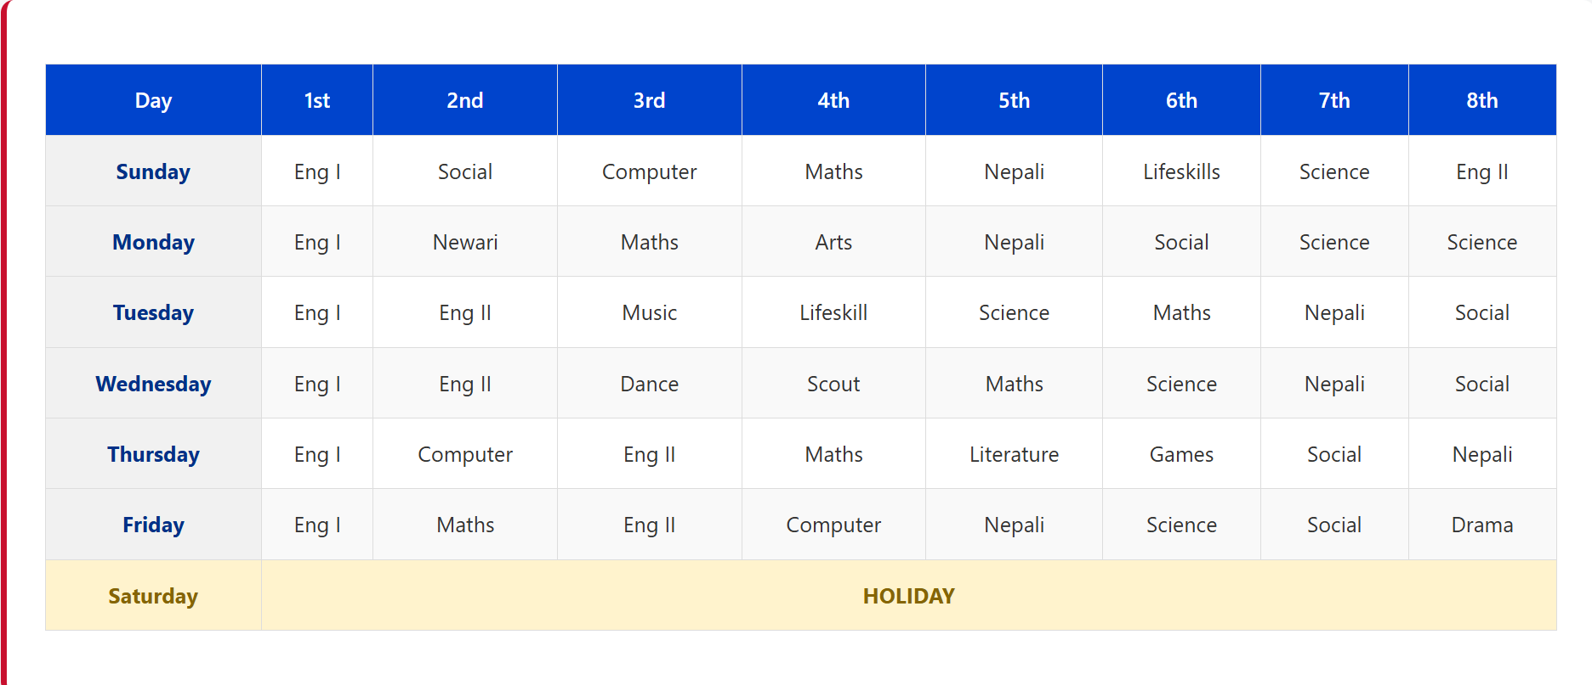
Digital Timetable
Digital Timetable- Remembering daily timetable is very frustrating that’s why digital timetable helps students as it will show the timetable which is uploaded by teacher. They can also view which period is running.

Slide 5
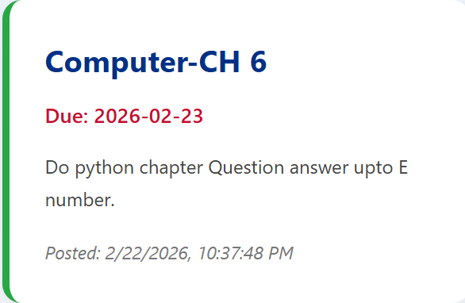
Digital Diary
Digital homework sender saves a lot of energy as writing in diary is time taking for students.

Slide 6
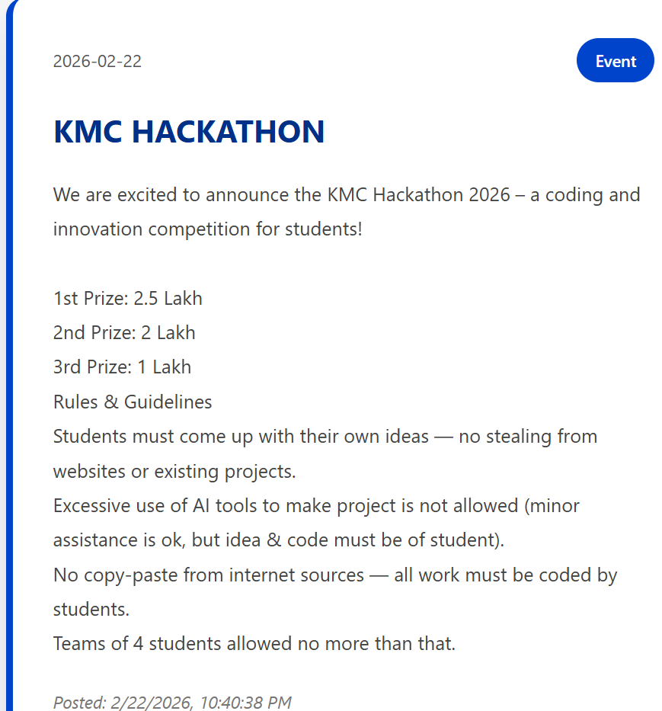
Digital Diary
Digital Notices saves a lot of paper which is wasted by school printing notice and saves time as students can view it any time through internet.

Slide 7
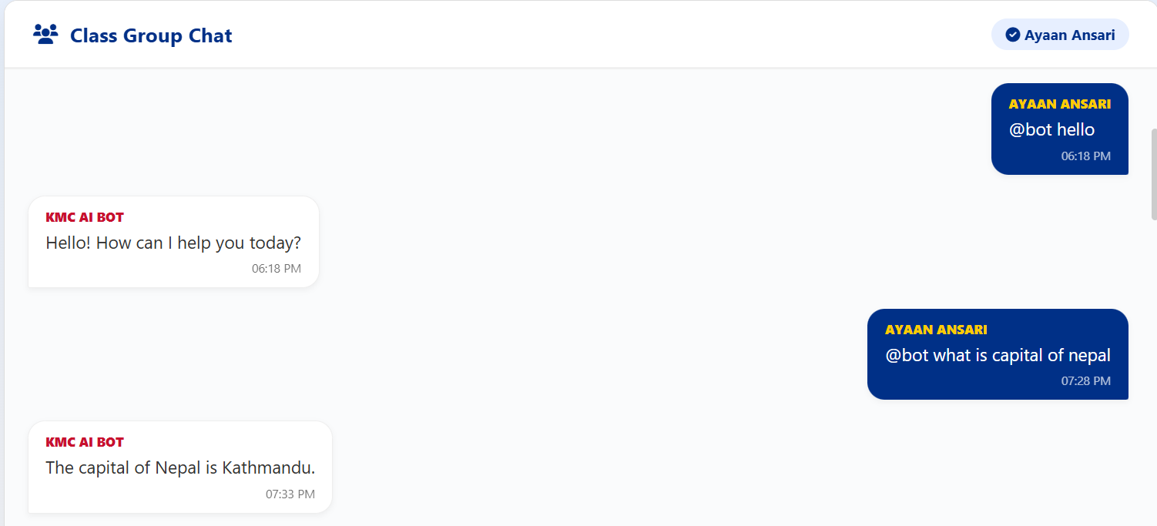
Chat App
A chat app to talk with students and have AI Integration to know answers of questions.

Slide 8
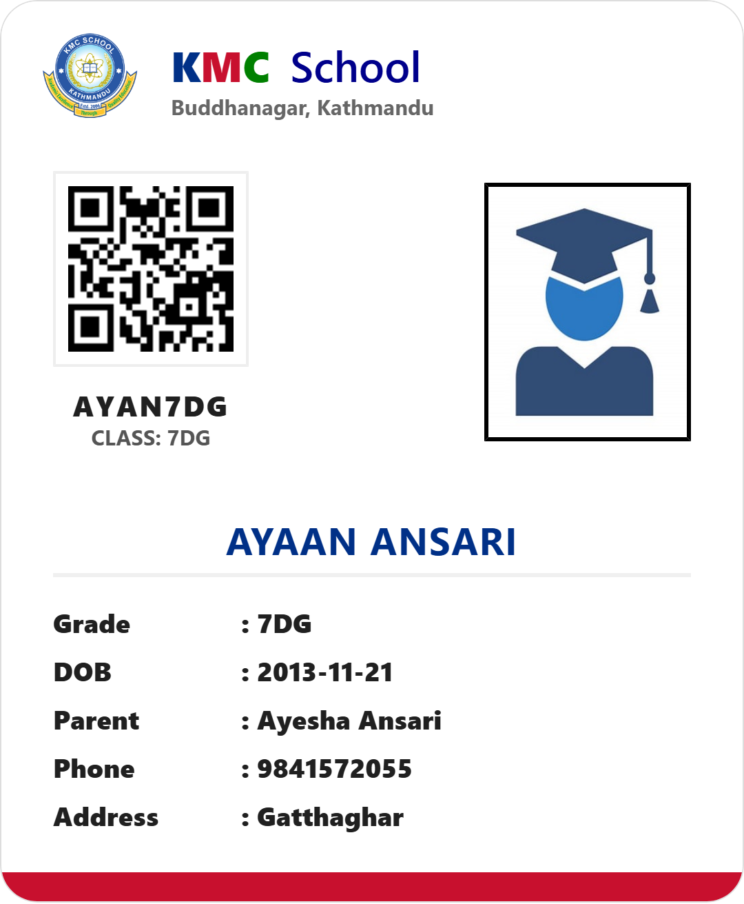
🆔 Digital ID Card System
📥 Download ID Card
One-click PNG download of student ID card
High-resolution image (3x scale) via html2canvas
Auto-named file: KMC_ID_{StudentName}.png
Professional card design with school branding
Includes QR code for verification
🔳 QR Code Generation
Auto-generated unique code per student
Code format: First2Letters + Last2Letters + Grade
Example: Ayaan Ansari, Grade 7 → AYAN7DG
QR code size: 80x80 pixels
Embedded in ID card for scanning
Generated using QRCode.js library
Digital ID card generated for students. If students will lose their ID card they can use this digital ID card.

Slide 9
🔒Secure Portal
🔐 Security & Sessions
🔑 Password Management
Single device enforcement policy
Unique session token per login
Real-time session monitoring via Firebase
Auto-logout when new device logs in
Login history with device & browser info
Kick notification when session expires
Password security system.
Can change account password from profile settings if any other student got access to their account

Slide 10
Teacher Portal Features
01
02
03
📊 Dashboard
✅ Attendance
📝 Homework Manager
Overview of today's schedule, period status, exam countdown, and latest school notices.
Mark Present/Absent/Late. Daily charts, weekly/monthly/yearly analytics, Nepali date converter.
Create, edit, delete assignments with title, description, due dates. Real-time Firebase sync.
04
05
06
📅 Timetable Editor
📢 Notice Board
📋 To-Do / Resources
Fully editable 8-period schedule. Click any cell to modify, cloud sync to Firebase.
Publish announcements with tags (Exam, Competition, Event). Include exam routines with tables.
Post materials and reminders with optional links. Categories: Reminder and Material.
07
08
09
💬 Parent Feedback
📈 Analytics
🔐 Secure Login
View all submitted feedback, send replies, mark as resolved. Track status: pending/replied.
Chart.js powered visualizations: daily bar charts, weekly comparison, monthly trends.
Teacher-specific authentication with role-based access control for all teacher features.

Slide 11
📊 Attendance System
📝 Daily Attendance
📈 Analytics & Reports
Mark Present, Absent, or Late for each student
Quick buttons: Mark All Present/Absent/Late
Real-time save to Firebase Firestore
Daily summary with pie/bar chart
Absent student notification center
View past attendance by date
Daily attendance chart (Present/Absent/Late)
Weekly comparison (last 7 days)
Monthly trends with Nepali date tooltips
Yearly summary by Nepali months
Export to Excel (XLSX format)
Percentage calculations for each category
🇳🇵 Nepali Date Support
☁️ Cloud Features
Automatic Nepali (B.S.) date conversion
12 Nepali months: Baisakh to Chaitra
B.S. date displayed on attendance form
Chart tooltips show Nepali dates
Yearly analytics in Nepali calendar
Gregorian to Bikram Sambat conversion
Automatic sync to Firebase
Real-time updates across all devices
Data backup and preservation
Offline-capable with sync on reconnect
Student email integration for notifications
Secure data with Firebase security rules

Slide 12
Technology Stack
🌐
🎨
⚡
🔥
🤖
Python
HTML5
CSS3
JavaScript
Firebase
Gemini AI
💻 Frontend Development
⚙️ Backend & Infrastructure
Modern responsive UI/UX with CSS Grid & Flexbox
Interactive interfaces with smooth animations
Cross-browser compatibility (Chrome, Firefox, Edge)
Mobile-first responsive design approach
Glassmorphism effects and gradient backgrounds
Real-time data binding with Firebase listeners
Firebase Firestore NoSQL cloud database
Real-time data synchronization across all clients
Python automation bot with Gemini 2.5 AI
Cloud-based data storage and backup
Session management with localStorage
Chart.js for analytics visualization

Slide 13
Interface Preview
Student Login
Student Dashboard
Teacher Dashboard
Attendance System
🎓
📊
👨‍🏫
✅
Homework Manager
Timetable
Notices
Class Chat + AI
📝
📅
📢
💬
Modern, intuitive interfaces with golden accent lines • Responsive design for all devices

Slide 14
🤖 AI Bot System
⚡
Real-time message responding using Gemini 2.5 Flash Lite AI
🤖
⚡
Monitors class chat for @bot mentions continuously
⚡
Answers student queries about school, subjects, schedules
⚡
Plain text responses only (no markdown formatting)
KMC AI BOT
⚡
24/7 operational capability running on Python server
⚡
Firebase Firestore integration for message storage
Powered by Gemini 2.5 Flash Lite
⚡
Python automation with logging and error handling
⚡
Automatic timestamp and sender tracking

Slide 15
🏫
Thank You
KMC School Management System

